Slide 1

Bitcoin: A Peer-to-Peer Electronic Cash System
AK0922

Slide 2

Outline
Introduction
Transactions
Timestamp Server
Proof-of-work
Network
Incentive
Reclaiming disk space
Simplified Payment Verification
Combining splitting value
Privacy
Calculations
Conclusion

Slide 3

Introduction
What is BitCoin ?
A decentralized digital/virtual currency .
Crypto Peer to Peer currency.
Problem:
A Purely Peer to Peer version of electronic cash would allow online payments to be sent directly from one party to another without going through a financial institution.
Solution can be Digital signatures, but the main benefits are lost if a trusted third party is still required to prevent double-spending.

Slide 4
Introduction
Solution:
Peer-to-Peer distributed timestamp server to generate computational proof of the chronological order of transactions.
The network timestamps transactions by hashing them into a ongoing chain of hash based proof-of-work , forming a record that cannot be changed without redoing the proof-of-work.

Slide 5
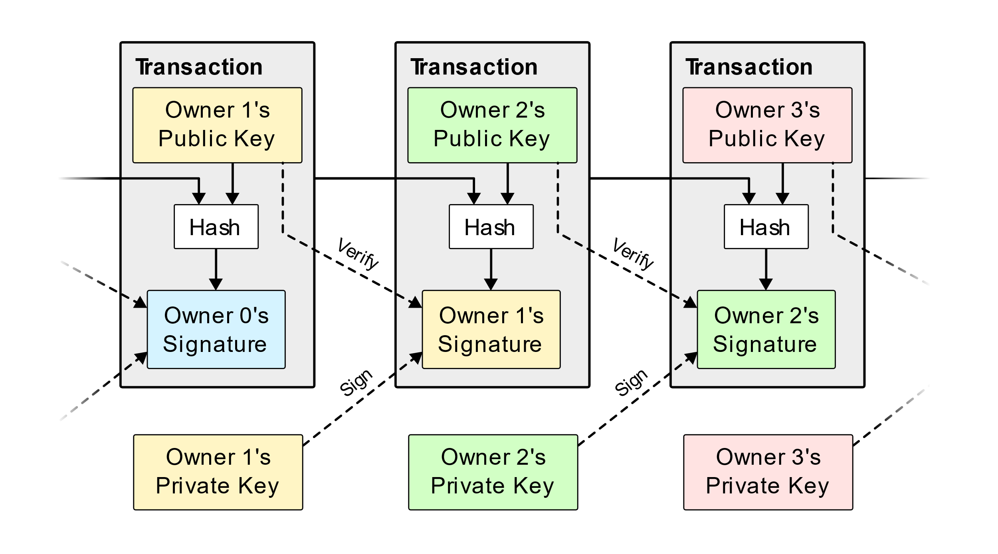
Transactions
Electronic Coin- chain of digital signatures
Payee cannot verify owner did not double spend
Without a trusted third party , transaction must be publicly announced, participants verify the single history of the order of the chain.

Slide 6
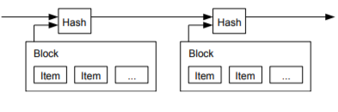
Timestamp Server
Timestamp server works by taking a hash of a block of items to be timestamped and widely publishing the hash.
Each timestamp include the previous timestamp in its hash, forming a chain.

Slide 7
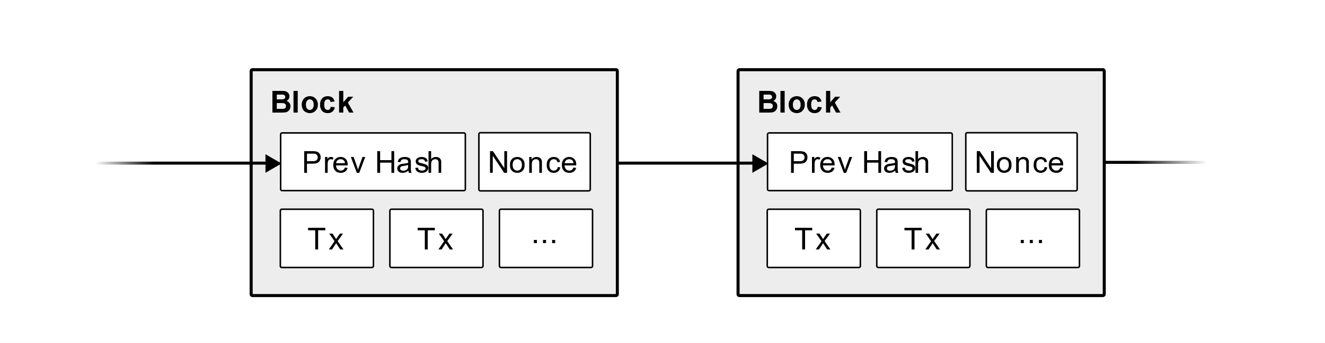
Proof-of-Work
It uses method of hashcash which requires the miners to cover all the data of the block before the block can be accepted.
Hashcash uses cryptographic hash equation to transform the blocks before they can be added to the block chain.
It is difficult to modify a block in middle of the chain as the hash value of the new block is different.

Slide 8
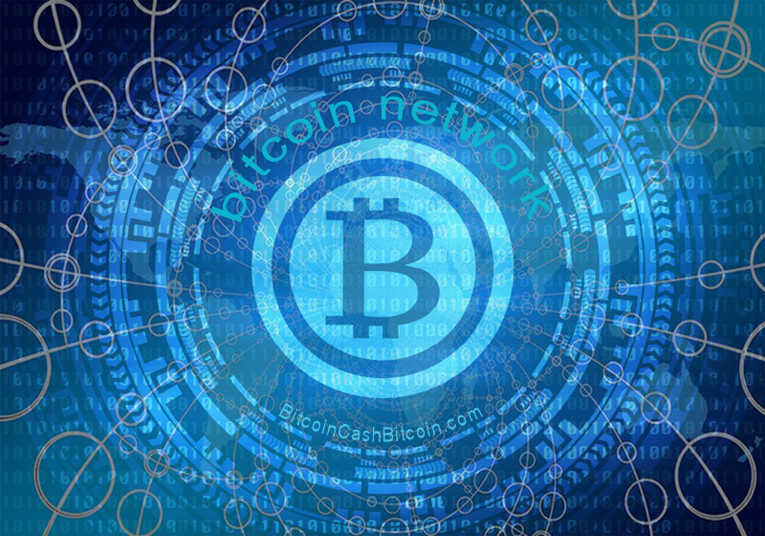
Network
Steps:
New transactions are broadcast to all nodes.
Each node collects new transactions into a block.
Each node works on finding a difficult proof-of-work for its block.
It broadcasts the block to all nodes, when it finds it.
Nodes accept the block if all transactions are valid and not already spent.
If the node is accepted, next block in the chain is created by using the hash of the accepted block as the previous hash.
Tie-Breaker when two nodes broadcast simultaneously
Sometimes, new transaction broadcasts may not receive all nodes

Slide 9

Incentive
First transaction in a block is special one that initiates new coin owned by the creator of the block.
Incentive for nodes to support the network
provides a way to initially distribute coins into circulation (no central authority) Eg: gold miners
CPU time and electricity that is expended.
The incentive can also be funded with transaction fees.
The incentive may help encourage nodes to stay honest.

Slide 10
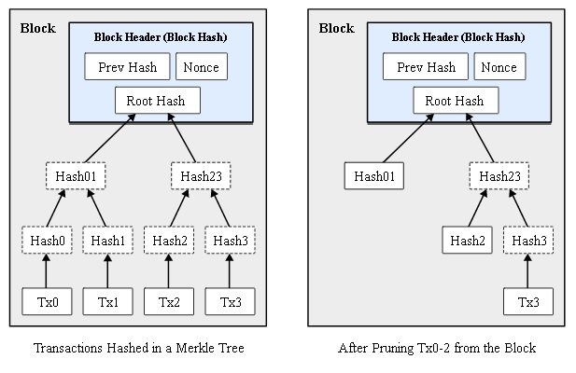
Reclaiming Disk Space
Once the latest transaction in a coin is buried under enough blocks, transactions are hashed in a Merkle Tree, with only the root included in the block's hash.
If we suppose blocks are generated every 10 minutes,
80 bytes * 6 * 24 * 365 = 4.2MB per year.

Slide 11
Simplified Payment Verification
It is possible to verify payments without running a full network node, by simply querying for the longest chain, and obtain the Merkle branch
The user can't check the transaction for himself, but by linking it to a place in the chain, he can see that a network node has accepted it, and blocks added after it further confirm the network has accepted it.
The verification is reliable as long as honest nodes control the network, but is more vulnerable if the network is overpowered by an attacker.

Slide 12
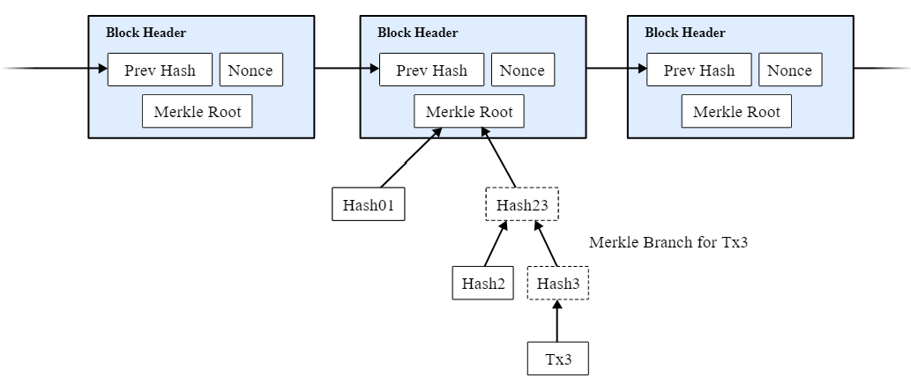
Simplified Payment Verification
Strategy: Alerts from network nodes when they detect an invalid block, prompting the user to download the full block and alerted transactions to confirm the inconsistency.

Slide 13
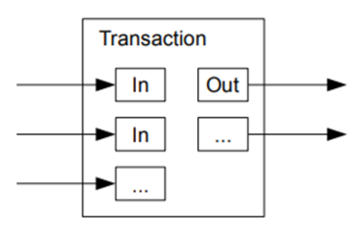
Combining and Splitting Value
Transaction contain multiple inputs and outputs. Normally with a single input from a larger previous transaction or multiple inputs combining smaller amounts, and two outputs: one for payment and one for returning.

Slide 14

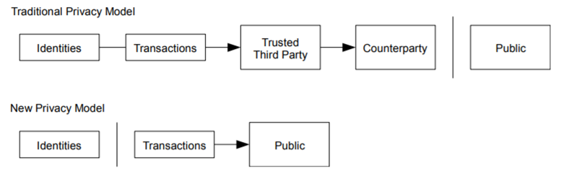
Privacy
The traditional banking model achieves a level of privacy by limiting access to information to the parties involved.
Privacy here can be maintained by keeping public keys anonymous (like stock exchanges).

Slide 15
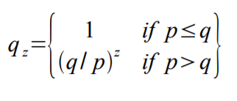
Calculations
The probability of an attacker catching up from a given deficit is analogous to a Gambler's Ruin problem as follows:
p = probability an honest node finds the next block
q = probability the attacker finds the next block
qz = probability the attacker will ever catch up from z blocks behind

Slide 16
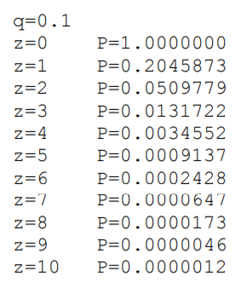
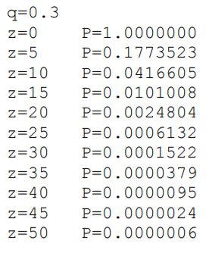
Calculations
Running some results, we can see the probability drop off exponentially with z.

Slide 17
Conclusion
They Proposed a system for electronic transactions :
without trust third party,
fast,
secure,
privacy,
low cost,
everyone can access it.

Slide 18


